Slide 1
DATAWAREHOUSING AND DATAMINING
CAP 446/447
LECTURE #0

Slide 2
COURSE DETAILS
LTP – 3/0/0 [Three lectures/week]
Text Book
  Data Mining: Concepts and Techniques by Jawei Han, Micheline Kamber and Jian Pe, Morgan Kaufmann Publishers, 3rd Edition, (2011)

Slide 3
THE COURSE CONTENTS
1. Data Warehousing and Online Analytical Processing
2. Introduction to data mining
3. Data Preprocessing
4. Association and Correlation Analysis
5. Clustering Algorithms and Cluster Analysis
6. Classification

Slide 4
COURSE ASSESSMENT MODEL
Marks break up
Attendance 5
CA 20
MTE 25
ETE 50
Total 100

Slide 5
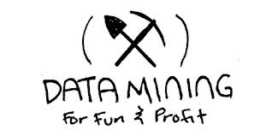
WHAT IS DATA MINING??????
Data mining is considered as a process of extracting data from large data sets to recognize meaningful pattern
It looks for anomalies, patterns or correlations among millions of records to predict results

Slide 6

EXAMPLES
Marketing: Data mining is used to explore increasingly large databases and to improve market segmentation. By analysing the relationships between parameters such as customer age, gender, tastes, etc., it is possible to guess their behaviour in order to direct personalised loyalty campaigns
Medicine: Data mining enables more accurate diagnostics. Having all of the patient's information, such as medical records, physical examinations, and treatment patterns, allows more effective treatments to be prescribed.

Slide 7
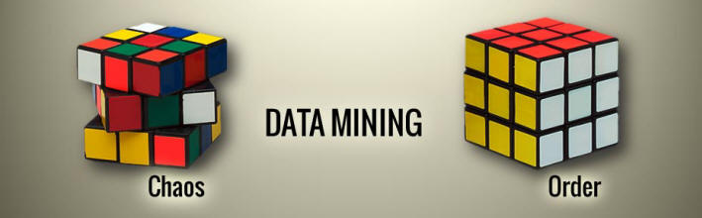
HOW TO BRING ORDER TO CHAOS
(DATA MINING TECHNIQUES)
Clustering: The given data is divided into different groups by combining similar objects into a group. This group is nothing but a cluster. A cluster is nothing but a collection of similar data which is grouped together.
Data Visualization: Set of data points and information that are represented graphically to make it easy and quick for user to understand. Eg. Through Graphs, Charts or Maps
Association: Association rule mining finds interesting associations and relationships among large sets of data items
Data Cleaning: Fixing or removing incorrect, corrupted, incorrectly formatted, duplicate, or incomplete data within a dataset. If data is incorrect, outcomes and algorithms are unreliable, even though they may look correct.

Slide 8
DATA WAREHOUSE

Slide 9

DATA WAREHOUSE
A Data Warehouse (DW) is a relational database that is designed for query and analysis rather than transaction processing. It includes historical data derived from transaction data from single and multiple sources.
A Data Warehouse is a group of data specific to the entire organization, not only to a particular group of users.
Data Warehouse environment contains an extraction, transform, and loading (ETL) solution
It includes current and historical data to provide a historical perspective of information.

Slide 10
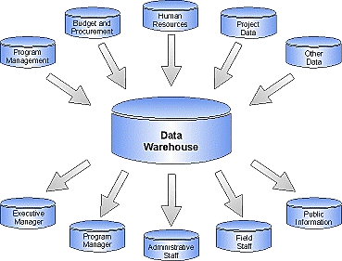

Slide 11
DATA WAREHOUSE VS DATA MINING

Slide 12
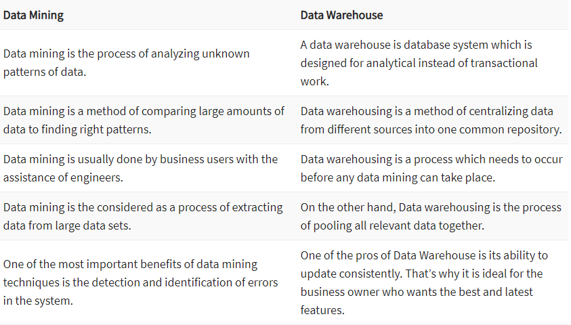
DATA MINING VS DATA WAREHOUSE

Slide 13
DATAWAREHOUSE DESIGN
A Data Warehouse is A single data repository where a record from multiple data sources is integrated for online business analytical processing (OLAP). This implies A data warehouse needs to meet the requirements from all the business stages within the entire organization. Thus, data warehouse design is hugely complex, lengthy, and hence error-prone process.

Slide 14
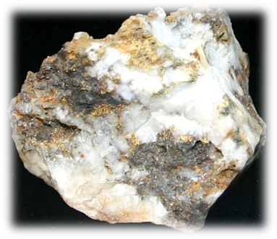
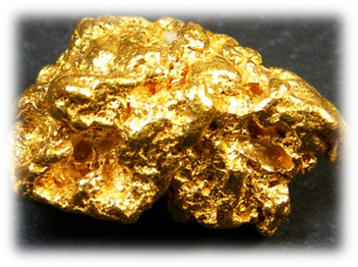
1. DATA CLEANING
DATA PREPROCESSING
Data Cleaning: Fixing or removing incorrect, corrupted, incorrectly formatted, duplicate, or incomplete data within a dataset. If data is incorrect, outcomes and algorithms are unreliable, even though they may look correct.

Slide 15
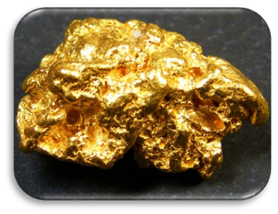
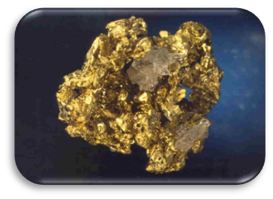
2. DATA INTEGRATION
DATA PREPROCESSING
SILVER
Data Integration: Combining data from multiple heterogeneous data sources into coherent data source and provide unified view of data. Sources may include data cubes, databases or flat files.
COPPER
PLATINUM
PALLADIUM

Slide 16
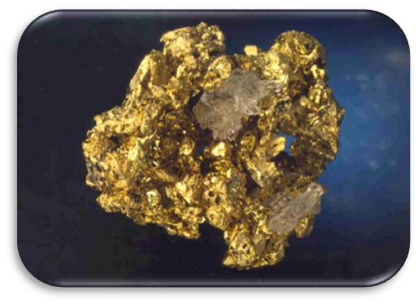
DATA PREPROCESSING
3. DATA TRANSFORMATION
.
Data Transformation: Data transformation is a technique used to convert the raw data into a suitable format that efficiently eases data mining and retrieves strategic information.
Data transformation includes data cleaning techniques and a data reduction technique to convert the data into the appropriate form

Slide 17

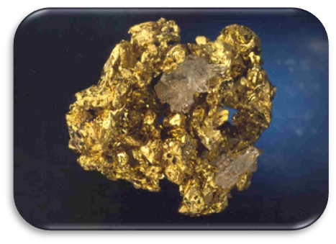
DATA PREPROCESSING
3. DATA TRANSFORMATION
Raw data
Clean / Transformed Data

Slide 18

ASSOCIATION AND CORRELATION ANALYSIS
Association refers to any relationship between two variables, whereas correlation is often used to refer only to a linear relationship between two variables
Your caloric intake and your weight.
Your eye color and your relatives' eye colors.
The amount of time your study and your CGPA.

